Slide 1





Entrepreneurial
Business Idea Title
NEXTGEN
CAMPUS PROS
Zafar Ali - BSCE20040

Slide 2
Problem Overview
Generalized deficiency in soft skills is widespread, affecting a broad spectrum of individuals.
Soft Skills Index
(Scaled from 1 to 100):
2012: 75
2015: 70
2018: 65
2021: 60
2022: 58
University-bound students, especially during the school-to-university transition, often grapple with a lack of essential communication skills and knowledge.
Communication Skills Proficiency
(Percentage of Students):
2012: 85%
2015: 80%
2018: 75%
2021: 70%
2022: 68%
An overarching trend in the last decade reveals a concerning deficiency in professional preparedness among individuals.
Professional Preparedness Score
(Scaled from 1 to 100):
2012: 70
2015: 65
2018: 60
2021: 55
2022: 52

Slide 3


Slide 4

NextGen Campus Pros
A comprehensive solution designed to address the soft skills deficiency and challenges faced by university-bound students during the school-to university transition.
Features/Value Proposition | Why NextGen Campus Pros?
Personalized Holistic Development Comprehensive Skill-Set Enhancement Tech-Infused Learning Experience Flexible Learning Options Real-World Readiness Programs | NextGen Campus Pros is the tailored solution, addressing soft skills gaps for university-bound students with personalized programs, mentorship, and practical strategies for academic and professional success.

Slide 5
Customers Persona
i - University-Bound Students
ii - People Interested in Personal Developement
1
2
3
4
GEOGRAP- ICAL AREA
AGE
GENDER
BEHAVIORS
The program aims to cater to both male and female
students equally.
Focusing on students in the age range typically transitioning from
intermediate education to university.
High Academic Aspiration, Tech Savvy and People interested in Personal Developement
Targeting areas with a higher concentration of educational
institutions and university-bound students.

Slide 6



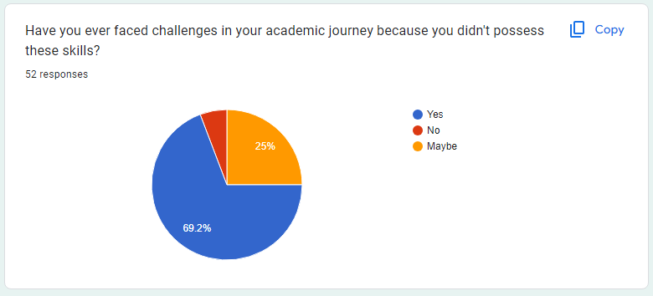
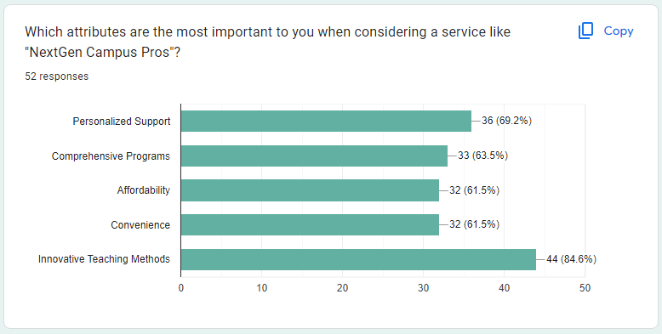
Market Validation
Proof for the Existence of Problem?

Slide 7
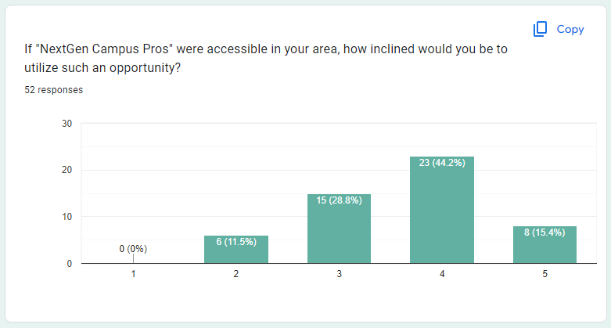
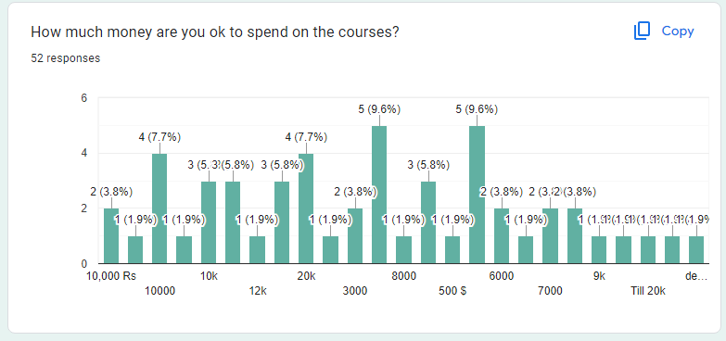
Market Validation
Proof for the Success of Idea?

Slide 8
Marketing Strategy
1
2
3
4
STRATEGIC DIGITAL PRESENCE
EDUCATIOLAL PARTNERSHIP INITIATIVES
THOUGHT LEADERSHIP COLLABORATIONS
INTERACTIVE VIRTUAL HUB
Create an immersive online platform beyond a typical website. Offer in-depth insights into courses, faculty profiles, and a streamlined enrollment process.
Utilize Facebook, Instagram, and LinkedIn for targeted advertising with analytics-driven precision. .
Form alliances with high schools, conducting unique promotional events.
Partner with influential education sector figures for credibility and extended reach.

Slide 9
Competitors/Substitutes
Online course platforms
Competitors
Traditional tutoring services
SkillSync Academy
What makes NextGen Campus Pros Unique? NextGen Campus Pros stands out by providing personalized learning paths tailored to individual student needs. Our extensive industry collaborations offer real-world insights, ensuring students are well-prepared for both academic challenges and future careers. With an immersive online platform, thought leadership collaborations, and a commitment to continuous excellence, NextGen Campus Pros offers a unique and comprehensive approach to soft skills development that goes beyond conventional alternatives.

Slide 10
Total Cash Required = 10 lacks (Approx)
Fixed Cost = 8 Lacks
Variable Cost = 2 Lacks (Approx)
The estimated cost of 10 lakhs is required for several essential components to establish and sustain NextGen Campus Pros effectively. Here's a breakdown of why this amount is necessary:
Faculty and Staff Salaries (30%): Marketing and Advertising (20%): Technology Infrastructure (15%): Administrative Costs (10%): Collaboration Expenses (10%): Others(15%)
Revenue Model

Slide 11









Revenue Model
Workshop and Seminar Fees
Course Fees
Collaboration Fees
Consultation Services
The Break-Even-Point for my Business Idea is at least 50 Students withing 6 months.

Slide 12
Business Model Canvas
KEY PARTNERS
KEY ACTIVITIES
VALUE PROPOSITIONS
CUSTOMER RELATIONSHIPS
CUSTOMER SEGMENTS
• High Schools
• Technology Providers
• Financial Institutions
• Online Learning Platforms
• Internship Providers
• Course Delivery
• Personalized Coaching
• Market Research
• Digital Marketing and Social Media Engagement
• Operational Logistics
• Personalized Holistic Development
• Tech-Infused Learning Experience
• Real-World Readiness Programs
• Flexible Learning Options
• Comprehensive Skill Set - Enhancement
• Personalized Guidance
• Continuous Engagement
• Feedback Mechanism
• Alumni Network
• Career Placement Services
University-Bound Students
• General Students
• Tech-Savvy
• Interested in Personal Development
• High Academic Aspiration
KEY RESOURCES
CHANNELS
• Educational Content
• Qualified Faculty and Staff
• Technology Infrastructure
• Legal and Compliance Expertise
• Social Media Platforms
• High School Collaborations
• Educational Influencers
COST STRUCTURE
REVENUE STREAMS
• Faculty and Staff Salaries
• Technology Infrastructure
• Marketing and Advertisement
• Operational Facilities
• Legal and Compliance
• Course Fees
• Workshop and Seminar Fees
• Collaboration Fees
• Online Course Licensing

Slide 13

Thank you for Listening!!
Any Questions?
I’m here for
You ☺ ..

